Slide 1
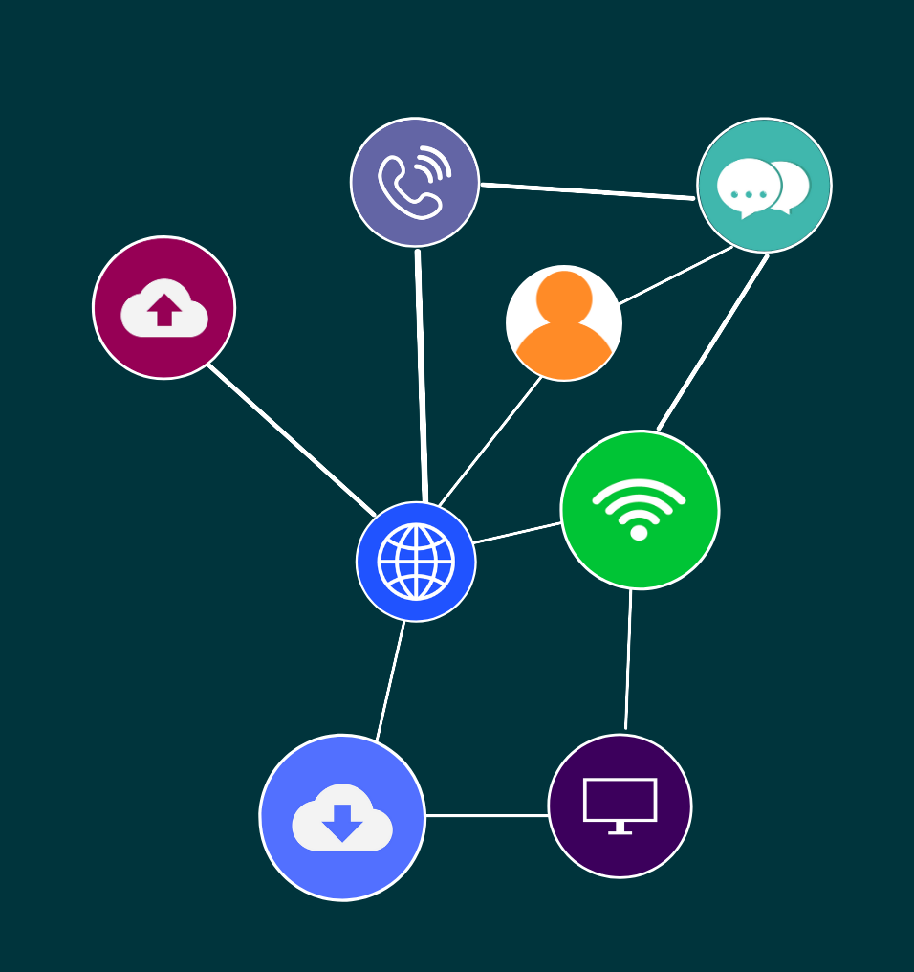
ICTSAD508
Develop technical requirements for business solutions

Slide 2

2
Topic 1: Researching the business solution

Slide 3
3
INTRODUCTION
A business solution for an organisation may come from the desire for change or to support achieving strategic objectives.
Topic 1: Researching the business solution
Topic 1: Insert topic title

Slide 4
4
ORGANISATIONAL REQUIREMENTS
Understanding an organisation’s requirements, standards, policies and procedures can provide information that can help you when developing technical requirements to enable business solutions to be implemented in an organisation.
Topic 1: Researching the business solution
Topic 1: Insert topic title

Slide 5

5
ACTIVITY: READ
What are the Australian code of ethics and how does it relate to working with a client to develop technical requirements for business solutions?
Topic 1: Researching the business solution

Slide 6
6
BUSINESS MODELS AND SOLUTIONS
Another important factor in establishing business solution requirements is to determine the business model.
Business models describes how an organisation creates, delivers, and captures value. It describes how the business operates.
Topic 1: Researching the business solution
Topic 1: Insert topic title

Slide 7
7
BUSINESS PROCESS DESIGN
Business process design is concerned with developing an effective approach to tasks that have to be performed within a business. Therefore, tasks are defined and then documented in a work flow that ensures they are performed to requirements and that no steps are missed.
Topic 1: Researching the business solution
Topic 1: Insert topic title

Slide 8
8
CUSTOMER AND BUSINESS LIAISON PROCESSES
Customer and business liaison processes provide integrated support services to customers.
These business liaisons may focus on helping customers understand, explore and acquisition technology solutions.
Topic 1: Researching the business solution
Topic 1: Insert topic title

Slide 9
9
CORPORATE STRATEGIES AND BUSINESS SOLUTIONS
When exploring possible business solutions, corporate strategies can be very influential, for example, if the organisation’s objective is to minimise costs, then this will be a major factor in the solution chosen.
Topic 1: Researching the business solution
Topic 1: Insert topic title

Slide 10
10
ACTIVITY: GROUP WORK
Research at least four ways that you can discover the business requirements of a client.
Topic 1: Researching the business solution

Slide 11
11
HARDWARE, SOFTWARE AND NETWORK REQUIREMENTS
The next step in researching a business solution is to define and analyse the hardware, software and network requirements.
Topic 1: Researching the business solution
Topic 1: Insert topic title

Slide 12
12
ACTIVITY: PRACTICAL
Each person in the group should test their current internet speed twice, using the ping test (speedtest.net).
Topic 1: Researching the business solution

Slide 13

13
TECHNICAL SPECIFICATIONS
Technical specifications will outline both what the current ICT infrastructure is in place and also what is required.
Topic 1: Researching the business solution
Topic 1: Insert topic title

Slide 14
14
ACTIVITY: PRACTICAL
Have a look at the computer you are working on.
Type up a technical specification for both hardware and software relating to the computer you are working on. Include software installed, hardware connected and peripherals.
Draw an overview of the network set up in the classroom that you are currently in.
Type up your technical specification into a word document. Use a table to display your information.
Topic 1: Researching the business solution

Slide 15
15
INTERFACE REQUIREMENTS
Hardware interface
Software interface
Further interface requirements
Topic 1: Researching the business solution
Topic 1: Insert topic title

Slide 16

16
SECURITY REQUIREMENTS
The security requirements for a business solution will be dependent upon organisational needs, compliance to legislation and standards as well as functionality.
Topic 1: Researching the business solution
Topic 1: Insert topic title

Slide 17
17
DOCUMENTING THE PROPOSED BUSINESS SOLUTION
A requirements report is generally undertaken to confirm what the client has told you has been recorded and documented.
Topic 1: Researching the business solution
Topic 1: Insert topic title

Slide 18
18
ACTIVITY: GROUP WORK
Write a requirements report.
Topic 1: Researching the business solution

Slide 19

19
Topic 2: The impact of technical solutions

Slide 20
20
SOFTWARE SOLUTIONS
The software solution should fit the business requirements and focus on the client needs.
Topic 2: The impact of technical solutions
Topic 1: Insert topic title

Slide 21
21
IDENTIFYING PROCESSES REQUIRING CHANGE
When a software solution has been defined, you will then need to identify processes requiring change by the business solution.
Topic 2: The impact of technical solutions
Topic 1: Insert topic title

Slide 22
22
IMPACT OF CHANGES
When implementing changes to a business solution, change management steps should be followed to ensure that the project is a success.
Any new ICT project will incur some type of change in process, policy or business.
Topic 2: The impact of technical solutions
Topic 1: Insert topic title

Slide 23
23
ACTIVITY: READ
See the following article on ITIL Change Management:
https://freshservice.com/change-management-software/itil-change-management
What is supply chain management?
https://scm.ncsu.edu/scm-articles/article/what-is-supply-chain-management-scm
See the following website for information about the Change Management Process:
https://www.prosci.com/resources/articles/change-management-process
Topic 2: The impact of technical solutions

Slide 24
24
SECURITY PROTOCOLS
When analysing the impact of technical solutions, you will also need to research the security protocols that are applicable to the business solutions being implemented.
Topic 2: The impact of technical solutions
Topic 1: Insert topic title

Slide 25
25
DOCUMENTATION
Documenting the project, goals and any impacts of changes should be done so according to any organisational requirements.
Topic 2: The impact of technical solutions
Topic 1: Insert topic title

Slide 26
26
ACTIVITY: GROUP WORK
Write a report on the impacts of technical solutions that relate to this scenario. Identify hardware, software and network requirements.
Identify software solutions to build business platform.
Identify processes to be changed by the business solution.
Determine the effect changes will have on the value or supply chain.
Research a range of security protocols suitable for business solutions.
Document impact of changes and submit to relevant stakeholders.
Topic 2: The impact of technical solutions

Slide 27
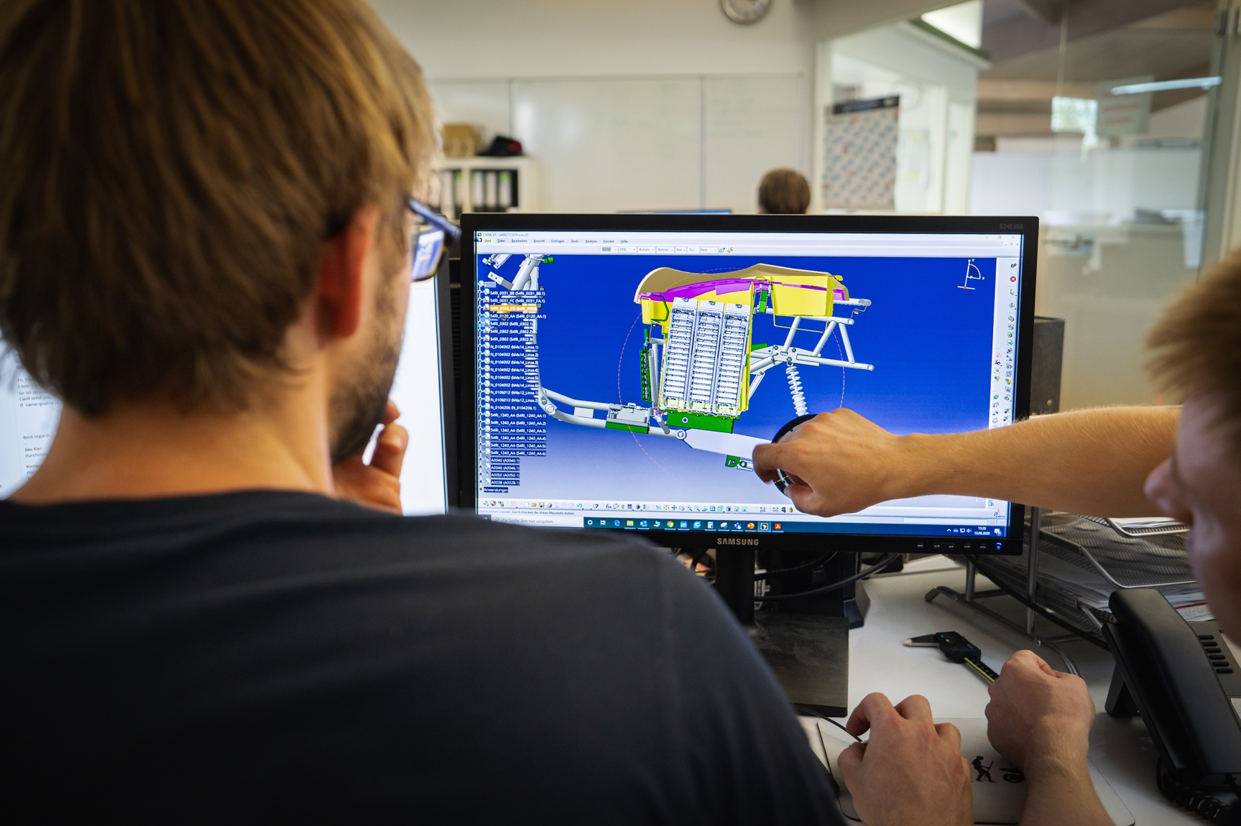
27
Topic 3: Implementing business solutions

Slide 28
28
IMPLEMENTING HARDWARE AND SOFTWARE SOLUTIONS
The next stage in developing the business solution is the implementation of the hardware and software solutions so that they can be tested. This may be via a virtual machine, trial software, prototypes or pilot tests.
Topic 3: Implementing business solutions
Topic 1: Insert topic title

Slide 29
29
ACTIVITY: READ
Review the support documentation from Microsoft for Server Testing:
https://docs.microsoft.com/en-us/windows-hardware/test/hlk/testref/server-testing-overview
Take any notes to summarise what you have read and keep for future reference.
Topic 3: Implementing business solutions

Slide 30
30
TRAINING NEEDS
Within the change management plan, should be an outline for training or a training plan. This should be developed to ensure that any gaps in knowledge and skills as a result of the business process change are addressed.
Topic 3: Implementing business solutions
Topic 1: Insert topic title

Slide 31
31
ACTIVITY: RESEARCH AND DISCUSS
If you were part of a project team to implement a new Operating System to a department, what skills could you bring?
Identify any gaps that you would have. Explain ways in which you could undertake professional development to fill any skill gaps.
Provide a link to at least two training development courses or events that you could attend to support your training in these areas.
Topic 3: Implementing business solutions

Slide 32
32
PLANNING TIMELINES AND ALLOCATION OF RESOURCES
The timing for projects and allocation of resources will be determined within the change management plan and could include:
Benchmarks and milestones for completion
A Gantt chart with timelines for activities
Allocation of resources
Action plans
Documentation from software development frameworks.
Topic 3: Implementing business solutions
Topic 1: Insert topic title

Slide 33
33
COSTS
A major aspect of developing business solutions will be the costs involved. There are four basic types of cost:
Fixed-Direct costs
Fixed-Indirect costs
Variable-Direct costs
Variable-Indirect costs.
Topic 3: Implementing business solutions
Topic 1: Insert topic title

Slide 34
34
ACTIVITY: READ
Read the following article and watch the embedded video on cost effective business solutions:
https://www.bridging-the-gap.com/cost-effective-solutions/ (10:41)
Take any notes to summarise what you have read and keep for future reference.
Topic 3: Implementing business solutions

Slide 35
35
ACTIVITY: GROUP WORK
Plan and undertake a number of tests for a website (choose one that is similar to your scenario).
Topic 3: Implementing business solutions

Slide 36

36
Topic 4: Validation and finalising activities

Slide 37
37
TESTING, VALIDATING AND DOCUMENTING RESULTS
A business solution can range from upgrading equipment to design and development of a new website.
The testing and validation will be specific to the project.
Topic 4: Validation and finalising activities
Topic 1: Insert topic title

Slide 38

38
VALIDATION
Validation is part of testing and an important step to ensuring the technical quality of a solution.
Topic 4: Validation and finalising activities
Topic 1: Insert topic title

Slide 39
39
ACTIVITY: RESEARCH AND DISCUSS
Run a website through the validator and take a screen shot of the result.
Create a test plan for a website for Usability, Accessibility, Functionality, Cross platform browser compatibility and Content checking.
Run your tests and document the results.
Draft an email to the Head of IT, explaining the test, the outcome of the results and recommendations for improvements based on the tests carried out.
Topic 4: Validation and finalising activities

Slide 40
40
COMPLETION AND DOCUMENTATION
Once testing and validation is complete then all the documentation and results should be reviewed for verification by the relevant personnel such as the project manager or client.
Topic 4: Validation and finalising activities
Topic 1: Insert topic title

